Slide 1
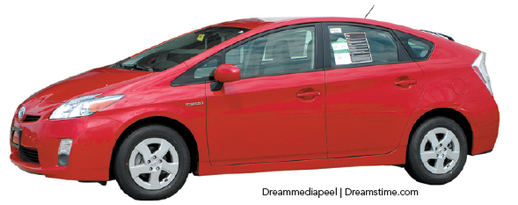
Building Blocks of Managerial Accounting
Chapter 2
Notes:
In this chapter, we discuss the different types of costs and terminology we need to understand as managers.

Slide 2
Objective 1
Distinguish among service, merchandising, and manufacturing companies
Notes:
Learning Objective 1 distinguishes among service, merchandising, and manufacturing companies.

Slide 3
Three types of companies
Service
Merchandisers
Manufacturers
Notes:
Organizations other than not-for-profits and governmental agencies are in business to generate profits for their owners. The types of companies in business to generate a profit generally fall into one of three categories: service, merchandisers, and manufacturers.

Slide 4
Service Companies
Sell and provide intangible services
No inventory
Other costs: services, develop new services, advertise etc.
Examples
Advertising agencies
Banks
Law firms
Insurance companies
Notes:
Service companies are in business to sell intangible services—such as health care, insurance, and consulting—rather than tangible products. Service firms now make up the largest sector of the U.S. economy. Because these companies sell services, they generally don’t have inventory or cost of goods sold accounts (which makes it fairly easy to calculate operating income). In addition to labor costs, service companies incur costs to develop new services, advertise, and provide customer service. Examples of service companies include advertising agencies, banks, law firms, and insurance companies.

Slide 5
Merchandisers
Resell products purchased from suppliers
One inventory account
Examples
Walmart
Best Buy
Amazon.com
Retailers vs. Wholesalers
Notes:
Merchandising companies such as Walmart and Best Buy resell tangible products they buy from suppliers. For example, Walmart buys clothing, toys, and electronics and resells them to customers at higher prices than what it pays its own suppliers for these goods. Merchandising companies include retailers (such as Walmart) and wholesalers. Retailers sell to consumers such as you and me. Wholesalers, often referred to as “middlemen,” buy products in bulk from manufacturers, mark up the prices, and then sell those products to retailers. Because merchandising companies sell tangible products, they have inventory. The cost of merchandise inventory is the cost merchandisers pay for the goods plus all costs necessary to get the merchandise in place and ready to sell. Because the entire inventory is ready for sale, a merchandiser’s balance sheet usually reports just one inventory account called Inventory or Merchandise Inventory. Merchandisers also incur other costs to identify new products and locations for new stores, to advertise and sell their products, and to provide customer service. Costs to be included in inventory include freight, taxes, and so on.

Slide 6
Manufacturers
Use labor, plant, and equipment to convert raw materials into finished products
Examples
Procter & Gamble
General Mills
Dell Computer
Toyota
Three inventory accounts
Notes:
Manufacturing companies use labor and other inputs (including plant and equipment) to convert raw materials into finished products.
Manufacturers sell their products to retailers or wholesalers at a price that is high enough to cover their costs and generate a profit. Examples of manufacturers include Procter & Gamble, General Mills, and Dell Computer.
There are three inventory accounts in manufacturing companies, which will be explained with the next slide.

Slide 7
Manufacturers
Three inventory accounts
Raw materials: Steel, Rubber, Glass
Work in process: Partially completed vehicles
Finished goods: Completed goods that have not yet been sold
Notes:
There are three inventory accounts in manufacturing companies:
1. Raw Materials inventory includes all raw materials used in manufacturing or building a product. No labor is included in raw materials.
2. Work in process inventory includes all goods that are partway through the manufacturing process but not yet complete (raw materials plus some labor and manufacturing overhead).
3. Finished goods inventory includes completed goods that have not yet been sold. Although most manufacturers sell their finished goods inventory to merchandisers, some manufacturers sell their products directly to consumers. (Finished goods inventory includes all costs associated with the product.)

Slide 8
Objective 2
Describe the value chain and its elements
Notes:
Learning Objective 2 describes the value chain and its elements. Every company has a value chain that includes all the steps in a product from the initial idea to the sale to the customer.

Slide 9
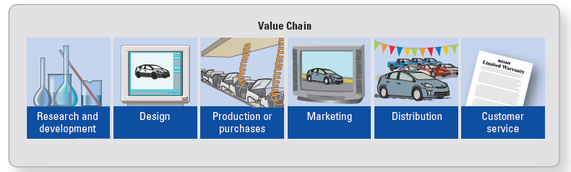
Value Chain
Activities that add value to products and services and cost money.
Notes:
The activities in a value chain are the activities that add value to products and services. These activities use company resources, such as time or money. The value chain includes all activities from the inception of a product idea through the final delivery to the customer. The value chain incorporates six major activities (all of the examples included here are for the value chain connected with producing an automobile):
1. Research and Development: research costs associated with developing a fuel-efficient and safe car (researching and developing new or improved products or services and the processes for producing them)
2. Design: the specifications for the dimensions and engine characteristics for the car (detailed engineering of products and services and the processes for producing them)
3. Production (manufacturer) or Purchases (merchandiser): sheet metal used to build the car and the assembly-line worker’s wages to build the car (resources used to produce a product or service or to purchase finished merchandise intended for resale)
4. Marketing: advertising and promotion costs (promotion and advertising of products or services. The goal of marketing is to create consumer demand for products and services.)
5. Distribution: costs of delivering the car to the customer (delivery of products or services to customers)
6. Customer Service: costs of providing warranty service to the purchaser of the car (support provided for customers after the sale)
Many of the value-chain activities occur in the order discussed here. However, cross-functional teams also work on R&D, design, production, marketing, distribution, and customer service simultaneously.

Slide 10
Cost from Value Chain Activities
Research and Development (R&D)
Design
Production or Purchase
Marketing
Distribution
Customer Service

Slide 11
Example from Textbook: E2-18A
Cost incurred | Category of the value chain
Newspaper advertisements
Payment to consultant for advice on location of new store
Purchases of merchandise
Freight-in
Salespeople’s salaries
Depreciation expense on delivery trucks
Research on whether store should sell satellite radio service
Customer Complaint Department
Rearranging store layout
Marketing
R&D
Purchases
Purchases
Marketing
Distribution
R&D
Customer Service
Design
Copyright © 2015 Pearson Education, Inc.
Notes:
For this exercise we are to classify each cost as to which category of the value chain it belongs. The categories are: R&D, Design, Purchases, Marketing Distribution, or Customer Service. Now let’s work through each one together.
Newspaper advertisements: The category would be marketing because we are advertising our product for sale.
Payment to consultant for advice on location of new store: The category would be R&D because we are paying a consultant to give us advice on a location for a new store.
Purchases of merchandise: The category would be purchases because we are purchasing merchandise for resale.
Freight-in: The category would be purchases because we are incurring this cost due to purchasing merchandise.
Salespeople’s salaries: The category would be marketing because we are incurring this cost due to trying to sell our product.
Depreciation expense on delivery trucks: The category would be distribution because this cost is incurred due to distributing our product.
Research on whether store should sell satellite radio service: The category would be R&D because we are incurring this cost due to trying to determine if we should sell a particular service.
Customer Complaint Department: The category would be customer service because we are incurring this cost due to having a department to service our customer.
Rearranging store layout: The category would be design because we are incurring this cost to rearrange the layout of our store.

Slide 12
Objective 3
Distinguish between direct and indirect costs
Notes:
Learning Objective 3 distinguishes between direct and indirect costs.

Slide 13
Cost Object
Anything for which managers want a separate measurement of cost
Direct cost: A cost can be traced to the cost object
e.g.: cost of steel, cost of tires etc.
Indirect cost: A cost that relates to the cost object but cannot be traced to it.
e.g.: warehouse utilities
Notes:
First, a cost object must be defined. A cost object is anything for which managers want a separate measurement of cost, such as:
• Individual units (a specific, custom-ordered Prius)
• Different models (the Prius, Rav4, and Corolla)
• Alternative marketing strategies (sales through dealers versus built-to-order Web sales)
• Geographic segments of the business (United States, Europe, Japan)
• Departments (human resources, R&D, legal)
• A “green” initiative (developing fuel cells)
A direct cost is a cost that can be traced directly to a cost object; for example, a steering wheel used in the production of a car would be a direct cost. An indirect cost is a cost that cannot be directly traced to the cost object; for example, the cost of lubricants used in the manufacture of a car. Another example would be a plant manager’s wages. These wages would not be traceable to a single product.
If a company wants to know the total cost attributable to a cost object, it must assign all direct and indirect costs to the cost object. Assigning a cost simply means that you are “attaching” a cost to the cost object. Direct costs are assigned by “tracing” these costs to specific units. Because indirect costs cannot be traced to specific units, they are “allocated” to the cost objects, and per-unit costs are more of an estimate. The terminology is important because it helps managers understand how accountants arrive at cost figures.

Slide 14
Assign Direct Cost and Indirect Cost
Assign direct and indirect costs to cost object:
Trace: direct costs to cost objects
Amount of cost assigned to the cost object is very precise
Allocate: indirect costs to cost objects
Amount of cost assigned to the cost object is less precise

Slide 15
Example from Textbook: S2-4
Cost incurred | Direct or indirect
Depreciation of the building
Cost of costume jewelry on the mannequins in the Juniors Department
Cost of bags used to package customer purchases at the main registers for the store
The Medina Kohl’s store manager’s salary
Cost of the security staff at the Medina store
Manager of Juniors Department
Juniors Department sales clerks
Cost of Juniors clothing
Cost of hangers used to display the clothing in the store
Indirect
Direct
Indirect
Indirect
Indirect
Direct
Direct
Direct
Indirect
Notes:
15
For this exercise we are to classify each cost as a direct cost or an indirect cost, assuming that the cost object is the Juniors Department (clothing and accessories for teenage and young women) in the Medina Kohl’s department store. Now let’s work through each one together.
Depreciation of the building: This cost cannot be traced to the cost object, therefore the cost will be an indirect cost.
Cost of costume jewelry on the mannequins in the Juniors Department: This cost can be traced to the cost object, therefore the cost will be a direct cost.
Cost of bags used to package customer purchases at the main registers for the stores: This cost cannot be traced to the cost object, therefore the cost will be an indirect cost.
The Medina Kohl’s store manager’s salary: This cost cannot be traced to the cost object, therefore the cost will be an indirect cost.
Cost of the security staff at the Medina store: This cost cannot be traced to the cost object, therefore the cost will be an indirect cost.
Manager of Juniors Department: This cost can be traced to the cost object, therefore the cost will be a direct cost.
Juniors Department sales clerks: This cost can be traced to the cost object, therefore the cost will be a direct cost.
Cost of Juniors clothing: This cost can be traced to the cost object, therefore the cost will be a direct cost.
Cost of hangers used to display the clothing in the store: This cost cannot be traced to the cost object, therefore the cost will be an indirect cost.
The remainder of this problem will be covered on the next slide.

Slide 16
Example from Textbook: S2-4 (cont.)
Cost incurred | Direct or indirect
Electricity for the building
Cost of radio advertising for the store
Juniors clothing buyers’ salaries (these buyers buy for all of the Juniors Departments of Kohl’s stores)
Indirect
Indirect
Indirect
Notes:
16
Electricity for the building: This cost cannot be traced to the cost object, therefore the cost will be an indirect cost.
Cost of radio advertising for the store: This cost cannot be traced to the cost object, therefore the cost will be an indirect cost.
Juniors clothing buyers’ salaries: This cost may be a little confusing because it states it is for the Juniors Department, therefore you may want to assume it would be a direct cost, but it is not. Why? Because they buy for all of the Junior Departments for Kohl’s and not just for the Medina store.

Slide 17
Objective 4
Identify the inventoriable product costs and period costs of merchandising and manufacturing firms
Notes:
Learning Objective 4 identifies the inventoriable product costs and period costs of merchandising and manufacturing firms.

Slide 18
Three definitions of product cost
Total costs: used internally only (we will see this in later chapters- Chp8)
e.g., The total cost for Prius is to research, design, manufacture, market, distribute, and service.
Inventoriable product costs: Used for external reporting
Period costs: All costs incurred in the other stages of the value chain must be expensed in the period in which they are incurred
Notes:
To determine a product’s profitability, subtract the cost of the product from its selling price. Most companies use two different definitions of costs: (1) total costs for internal decision making and (2) inventoriable product costs for external reporting.
Total Costs include the costs of all resources used throughout the value chain. The total cost includes expenses incurred to research, design, manufacture, market, distribute, and service that model. Launching a new model, managers predict the total costs of the model to set a selling price that will cover all costs plus return a profit.
Inventoriable product costs include only the costs incurred during the “production or purchases” stage of the value chain.

Slide 19
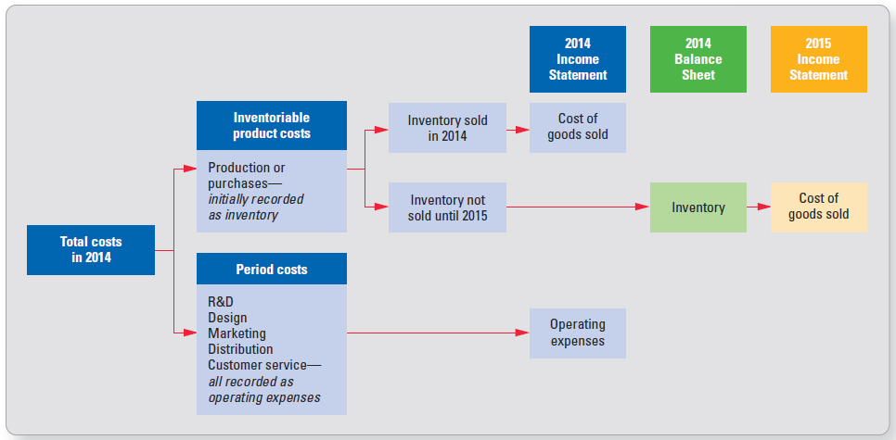
Inventoriable Product Costs and Period Costs
Notes:
Inventoriable product costs include only the costs incurred during the “production or purchases” stage of the value chain. Inventoriable product costs are treated as an asset (inventory) until the product is sold. Hence, the name “inventoriable” product cost. When the product is sold, these costs are removed from inventory and expensed as cost of goods sold. Because inventoriable product costs include only costs incurred during the production or purchases stage of the value chain, all costs incurred in the other stages of the value chain must be expensed in the period in which they are incurred. Therefore, we refer to R&D, design, marketing, distribution, and customer service costs as period costs.
Generally Accepted Accounting Principles (GAAP) does not allow companies to use total costs to report inventory balances or cost of goods sold in the financial statements. For external reporting, GAAP allows only a portion of total cost to be treated as an inventoriable product cost.

Slide 20
Merchandising Companies’ Inventoriable Product Costs
Merchandising companies’ inventoriable product costs =
cost of purchasing the inventory from suppliers
+
any costs incurred to get the merchandise to the merchandiser’s place of business and ready for sale.

Slide 21
Inventoriable Product Costs— Merchandiser
+ Purchase price from suppliers
+ Cost to get ready for sale
+ Freight-in
+ Import duties or tariffs
Notes:
These additional costs include freight-in costs and import duties or tariffs, if the products were purchased from overseas. Why does the cost of their inventory include freight-in charges? Think of the last time you made a purchase from an online website like Amazon.com. The website may have shown the product’s price as $15, but by the time you paid the shipping and handling charges, the product really cost you around $20. Likewise, merchandising companies pay freight-in charges to get the goods to their place of business (plus import duties if the goods were manufactured overseas). These charges become part of the cost of their inventory.

Slide 22
Inventoriable Product Costs— Manufacturer
Direct materials
Direct labor
Manufacturing overhead
Direct Costs
Indirect Costs
Notes:
A manufacturing company’s inventoriable product costs consist of direct materials, direct labor, and manufacturing overhead.
Direct Materials (DM): Manufacturers convert raw materials into finished products. Direct materials are the primary raw materials that become a physical part of the finished product.
Direct Labor (DL): Although many manufacturing facilities are highly automated, most still require some direct labor to convert raw materials into a finished product. Direct labor is the cost of compensating employees who physically convert raw materials into the company’s products.
Direct materials and direct labor are direct with respect to the cost object because they can be traced directly back to the product.
Manufacturing Overhead (MOH): The third production cost is manufacturing overhead.
Manufacturing Overhead includes all manufacturing costs other than direct materials and direct labor. In other words, manufacturing overhead includes all indirect manufacturing costs.

Slide 23
Manufacturing Overhead
Indirect costs related to manufacturing that are not direct materials or direct labor
Indirect materials
e.g., cleaning suppliers, oil and lubricant
Indirect labor
e.g., salaries, wage, benefits of forklift operators, securities
Other indirect manufacturing costs
e.g., depreciation expense of PP&E, insurance, maintenance fee
Notes:
Manufacturing overhead is made up of costs that cannot be traced to specific units; however, they are costs related to manufacturing operations.
Manufacturing overhead is also referred to as factory overhead because all of these costs relate to the factory.
Manufacturing overhead has three components: indirect materials, indirect labor, and other indirect manufacturing costs.
Indirect material includes materials used in the plant that are not easily traced to individual units (for example, janitorial supplies). Although it may be possible to trace the indirect materials such as glue used in a product, it would not be economically feasible. Indirect labor includes the cost of all employees in the plant other than those employees directly converting the raw materials into the finished product (for example, plant supervisor and janitors). Other indirect manufacturing costs include insurance and depreciation on the plant, plant equipment depreciation, plant property taxes, plant repairs and maintenance, and plant utilities.

Slide 24
S2-8
COST | Period Cost or Inventoriable Product Cost? | If an Inventoriable Product Cost: Is it DM, DL, or MOH?
1. Cost of milk purchased from local dairy farmers
2. Depreciation on Marketing Department’s computers
3. Property tax on dairy processing plant
4. Gasoline used to operate refrigerated trucks delivering finished dairy products to grocery stores
5. Company president’s annual bonus
6. Depreciation on refrigerated trucks used to collect raw milk from local dairy famers
7. Plastic gallon containers in which milk is packaged
8. Research and development on improving milk pasteurization process
9. Television advertisements for Dairy Plain’s products
10. Lubricants used in running bottling machines
11. Wages and salaries paid to machine operators at dairy processing plant
Product
DM
Period
Product
MOH
Period
Period
Product
MOH
Product
DM
Period
Period
Product
MOH
Product
DL

Slide 25
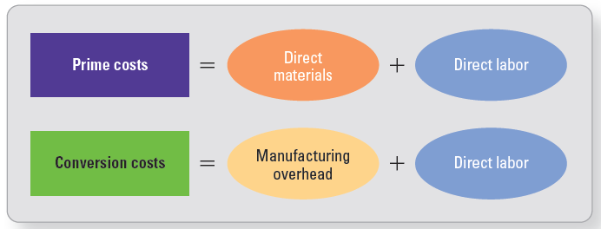
Prime and Conversion Costs
Notes:
Additional ways to define costs include the terms of “prime costs” and “conversion costs.” Prime costs include direct materials and direct labor. Prime costs used to be the primary costs of production. However, as companies have automated production with expensive machinery, manufacturing overhead has become a greater cost of production. Conversion costs include direct labor and manufacturing overhead—the costs incurred to turn materials into finished product. Never add conversion costs to prime costs because that would be adding direct labor twice.

Slide 26
Direct and Indirect Labor Costs Include
Salaries and wages
Fringe benefits
Payroll taxes
Chapter 3 for more details!
Notes:
The cost of labor, in all areas of the value chain, includes more than the salaries and wages paid to employees. The cost also includes company-paid fringe benefits such as health insurance, retirement plan contributions, payroll taxes, and paid vacations. These costs are very expensive. Fringe-benefit costs for all nonmanufacturing employees are expensed as period costs. Fringe-benefit costs for all employees working in the manufacturing plant become part of the inventoriable product cost.

Slide 27
Objective 5
Prepare the financial statements for service, merchandising, and manufacturing companies
Notes:
Learning Objective 5 addresses preparing the financial statements for service, merchandising, and manufacturing companies.

Slide 28
Income Statement—Service Company
Simplest income statement
All costs are period costs
Service revenues
– Operating expenses
Operating income
Operating expense: Salary expense, Office rent expense, Depreciation expense, Marketing expense etc.
Notes:
In a service company, all costs are period costs. There is no inventory, and operating income is the arithmetic difference between service revenue generated and operating expenses.
To determine “net income,” we would add or subtract nonoperating income and expenses, such as interest, and subtract income taxes. In general, “operating income” is simply the company’s earnings before interest and income taxes. Because service firms have no inventory, they have no inventoriable product costs to be concerned with.

Slide 29
Income Statement—Merchandiser
+ Sales
– Cost of goods sold
= Gross profit
– Operating expenses
= Operating income
Notes:
In a merchandising company, the income statement is prepared by first subtracting cost of goods sold from sales. This result is gross profit. From gross profit, operating expenses are subtracted to yield operating income.
Many companies do not show the computation of cost of goods sold directly on the face of the income statement, preferring to show only the cost of goods sold total.

Slide 30
Cost of Goods Sold Calculation— Merchandiser
+ Beginning inventory
+ Purchases
+ Import duties or tariffs
+ Freight-in
= Cost of goods available for sale
– Ending inventory
= Cost of goods sold
Notes:
The cost of goods sold calculation for an inventory system is calculated by adding purchases, import duties and freight-in to arrive at the cost of goods available for sale. At the end of the period, inventory is counted and subtracted from cost of goods available for sale. The result is the cost of goods sold, assuming no loss from spoilage, theft, and so on.

Slide 31
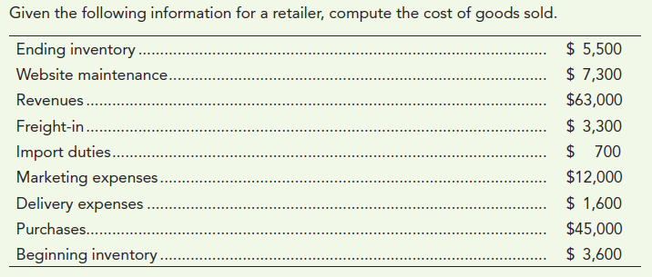
Now turn to S2-10
Notes:
Turn to S2-10.

Slide 32
S2-10
Cost of Goods Sold Computation
Beginning
inventory
$ 3,600
Purchases
$45,000
Import
duties
700
Freight
-
in
3,300
49,000
Cost
of goods
avail
for sale
52,600
Ending
inventory
(5,500
)
Cost of goods sold
$47,100
Copyright © 2015 Pearson Education, Inc.
Notes:
See the slide for the solution….

Slide 33
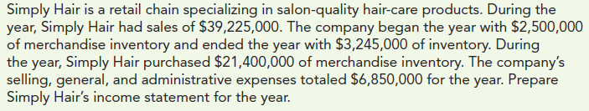
Now turn to S2-11
Notes:
Turn to S2-11.

Slide 34
S2-11
Simply Hair
Schedule of Cost of Goods Sold
Beginning inventory | $ 2,500,000
Purchases | 21,400,000
Cost of goods available | $ 23,900,000
Ending inventory | (3,245,000)
Cost of goods sold | $ 20,655,000

Slide 35
S2-11
Simply Hair
Income Statement
Sales revenue | $ 39,225,000
Cost of goods sold | 20,655,000
Gross profit | $ 18,570,000
Operating expenses | 6,850,000
Operating income | $ 11,720,000

Slide 36
Direct Materials Used Calculation— Manufacturer
+ Beginning raw materials inventory
+ Purchases of raw materials
+ Freight in
= Materials available for use
– Ending raw materials inventory
= Direct materials used
Notes:
Sometimes the exercise does not give you the direct materials used; you will then have to calculate it. The calculation for direct materials used is similar to that of cost of good sold. Beginning raw materials inventory is added to purchases of raw materials and the freight costs for acquiring the raw materials. Ending raw materials inventory is subtracted from this total to arrive at the direct materials used.
Note that this calculation assumes that all raw materials are direct materials.

Slide 37
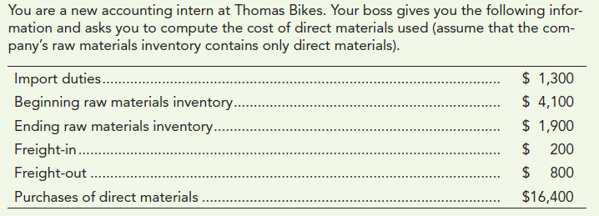
Now turn to S2-12
Notes:
Turn to S2-12. Using the format on the previous slide, calculate the direct materials used. When finished, return here so you can check your answer.

Slide 38
S2-12
Thomas Bikes
Computation of Direct Materials Used
Direct materials used:
Beginning
raw materials inventory
$ 4,100
Purchases of direct materials
$16,400
Import
duties
1,300
Freight
-
in
200
17,900
Direct
materials available for use
22,000
Ending
raw materials inventory
(1,900
)
Direct materials used
$20,100
Copyright © 2015 Pearson Education, Inc.
Notes:
See the slide for the solution….

Slide 39
Cost of Goods Manufactured Calculation—Manufacturer
+ Beginning work in process inventory
+ Direct materials used
+ Direct labor
+ Manufacturing overhead
= Total manufacturing costs to account for
– Ending work in process inventory
= Cost of goods manufactured
Notes:
The cost of goods manufactured calculation begins with beginning work in process inventory. Direct materials, direct labor and manufacturing overhead are added to the beginning work in process inventory to generate the total manufacturing costs. From this number, the ending work in process inventory is subtracted; this yields the cost of goods manufactured.
The manufacturer starts by buying direct materials, which are stored in raw materials inventory until they are needed for production. Only those direct materials used in production are transferred out of raw materials inventory and into work in process inventory. During production, the company uses direct labor and manufacturing overhead to convert these direct materials into a finished product. All units currently being worked on are in work in process inventory. When the units are completed, they are moved out of work in process inventory into finished goods inventory. The amount transferred into finished goods inventory during the year is the cost of goods manufactured.

Slide 40
How to Calculate
Beginning inventory + Net purchases =
Cost of goods sold + Ending inventory
Notes:
Understanding this equation enables you to solve for an unknown variable, assuming that the other three variables are known. It then becomes a very simple algebra problem.
For example, if it is known that beginning inventory was $10, ending inventory was $20, and cost of goods sold were $30, you can then figure out what net purchases amount to using basic algebra. 10 + Net Purchases = $30 + $20. Therefore, net purchases must have been $40.

Slide 41
Cost of Goods Sold Calculation— Manufacturer
+ Beginning finished goods inventory
+ Cost of goods manufactured
= Cost of goods available for sale
– Ending finished goods inventory
= Cost of goods sold
Notes:
Cost of goods sold for a manufacturing company uses the same formula as in a merchandising company, substituting cost of goods manufactured for cost of goods sold.
Notice that the term cost of goods manufactured is in the past tense. This is the manufacturer’s cost to obtain new finished goods that are ready to sell. Thus, it is the counterpart to the merchandiser’s purchases.

Slide 42

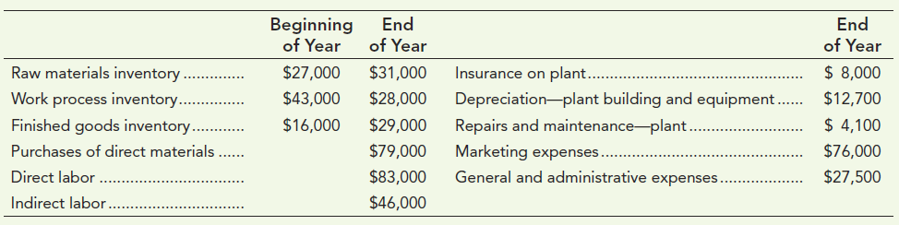
Now turn to E2-25A
Notes:
Turn to E2-25A.

Slide 43
E2-25A, Direct Materials Used
Blue Sea Company
Direct Materials Used
Beginning raw materials inventory | $ 27,000
Plus: Purchases of direct materials | 79,000
Available for use | $ 106,000
Less: Ending raw materials inventory | (31,000)
Direct materials used | $ 75,000

Slide 44
E2-25A, Cost of Goods Manufactured
Blue Sea Company
Schedule of Cost of Goods Manufactured
Beginning work in process inventory | $ 43,000
Plus: Manufacturing costs incurred:
Direct materials used | 75,000
Direct labor | 83,000
Manufacturing overhead* | 70,800
Cost of goods available | $ 271,800
Ending work in process inventory | (28,000)
Cost of manufactured | $ 243,800
*Manufacturing overhead:
Indirect labor | $ 46,000
Insurance on plant | 8,000
Deprec - Plant bldg and equip | 12,700
Repairs and maintenance – plant | 4,100
Manufacturing overhead (total) | $ 70,800

Slide 45
E2-25A, Cost of Goods Sold
Blue Sea Company
Schedule of Cost of Goods Sold
Beginning finished goods inventory | $ 16,000
Plus: Cost of goods manufactured | 243,800
Available for sale | $ 259,800
Less: Ending finished goods inventory | (29,000)
Cost of Goods Sold | $ 230,800

Slide 46
Income Statement—Manufacturer
+ Sales
– Cost of goods sold
= Gross profit
– Operating expenses
= Operating income
Notes:
The income statement for a manufacturing company is similar to that of a merchandiser. Sales minus cost of goods sold minus operating expenses equals operating income.

Slide 47
Now turn to E2-26A
Notes:
Turn to E2-26A.

Slide 48
E2-26A
Blue Sea Company
Income Statement
Sales revenue | $ 390,000
Cost of goods sold | 230,800
Gross profit | $ 159,200
Operating expenses
Marketing expenses | 76,000
General and admin expenses | 27,500
Operating income | $ 55,700

Slide 49
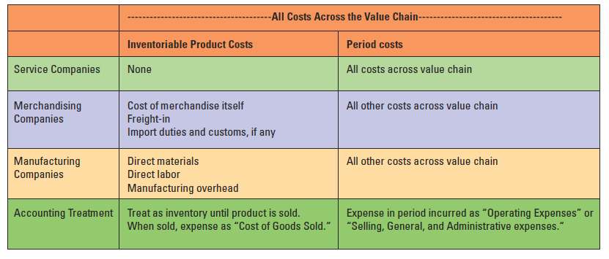
Product and Period Costs
Type of
Inventoriable
Period
Product Costs
Costs
Copyright © 2015 Pearson Education, Inc.
Notes:
This slide summarizes the product and period costs for each type of company: service, merchandising and manufacturing.
It is good to keep in mind the differences between service companies and merchandising/manufacturing companies. Service companies have no inventoriable product costs whereas merchandising/manufacturing do. Period costs are always expensed regardless of the type of company; product costs are placed in inventory first and then expensed when the sale is made.

Slide 50
Manufacturing Companies’ Inventory Accounts
Manufacturing companies show Raw Materials, Work in Process, and Finished Goods Inventory

Slide 51
Manufacturing Companies’ Inventory Accounts
Note: Sometimes manufacturers show “Inventories” on the face of the balance sheet, But disclose the breakdown of the inventory accounts (Raw Materials, Work in Process, and Finished Good Inventory) in the footnotes to the financial statements.

Slide 52
Manufacturing Companies’ Inventory Accounts
Raw Materials Inventory
+ Beginning inventory
– Materials used in work in process
+ Purchases and freight
= Ending inventory
Notes:
The flow of costs for materials inventory is shown here in T-account format.
Each inventory account starts with a beginning inventory balance.
It adds direct materials purchased to raw materials inventory.
It subtracts the ending inventory balance to find out how much inventory passed through the account during the period and on to work in process.
Beginning inventory
+ Direct materials purchased plus freight-in
= Direct materials available for use
– Ending inventory
= Direct materials used

Slide 53
Manufacturing Companies’ Inventory Accounts
Work in Process Inventory
+ Beginning inventory
– Cost of goods manufactured and sent to finished goods
+ Materials used from raw materials
+ Direct Labor
+ Manufacturing overhead
= Ending inventory
Notes:
The flow of costs through work in process inventory is shown here in T-account format.
The WIP inventory account starts with a beginning inventory balance, if not completed in a prior period.
It adds direct materials used, direct labor, and manufacturing overhead to work in process inventory.
It subtracts the ending inventory balance to find out how much inventory passed through the account during the period and on to finished goods.

Slide 54
Manufacturing Companies’ Inventory Accounts
Finished Goods Inventory
+ Beginning inventory
– Cost of goods sold
+ Cost of goods manufactured
= Ending inventory
Notes:
The flow of costs through the finished goods inventory account is shown here in T-account format.
The finished goods inventory account starts with a beginning inventory balance, if items were left unsold from a prior period.
It adds the cost of goods manufactured to finished goods inventory.
When products are sold, the cost of the finished goods is transferred to cost of goods sold.

Slide 55
Balance Sheet Differences
Type of Company | Inventory Accounts
Service Company | None
Merchandiser | Merchandise inventory
Manufacturer | Raw materials, work in process, and finished goods inventory
Notes:
The only difference in the balance sheets of service, merchandising, and manufacturing companies relates to inventories.

Slide 56
Objective 6
Describe costs that are relevant and irrelevant for decision making
Notes:
Learning Objective 6 describes costs that are relevant and irrelevant for decision making.

Slide 57
Controllable and Uncontrollable Costs
Controllable | Management can influence or change cost
Uncontrollable | Management cannot change or influence cost in the short run
Notes:
Controllable costs are costs that management can influence or change. Uncontrollable costs are costs that management cannot change or influence in the short run.
For example, let’s look at a Toyota. Management can control costs of research and development, design, and advertising, but they cannot control the cost of property tax and insurance of its existing plants.

Slide 58
Controllable and Uncontrollable Costs
Uncontrollable Costs:
e.g., property tax and insurance costs of its existing plants
Controllable Costs:
e.g., price paid for raw materials; research and development, design, and advertising

Slide 59
Relevant and Irrelevant Costs
Relevant | Differential costs, which are costs that differ between alternatives
Irrelevant | Costs that do not differ between alternatives or Sunk costs – costs incurred in the past that cannot be changed
Notes:
Relevant costs are costs that differ between alternatives; they are differential costs. Irrelevant costs are costs that do not differ between alternatives; they are referred to as “sunk” costs. Sunk costs are costs that have already been incurred. Management often has trouble ignoring sunk costs when making decisions, even though they should.
For example, let’s say you are trying to decide whether to sell your old car or buy a new one. The relevant costs in this decision would be the cost of repairs to your old car, trade-in value of your old car, the cost of the new car, and any other cost that would differ between the two alternatives. The amount you paid for your old car is irrelevant and considered a sunk cost. This is a hard mental barrier to overcome and is commonly seen in practice when managers do not want to get rid of old equipment because “they paid a lot for it.”
When making decisions, management must also consider qualitative factors (such as effect on employee morale) in addition to differential costs.

Slide 60
Objective 7
Classify costs as fixed or variable and calculate total and average costs at different volumes
Notes:
Learning Objective 7 classifies costs as fixed or variable and calculates total and average costs at different volumes.

Slide 61
Cost Behavior (Chp6 details)
Variable costs | Change in total cost in direct proportion to changes in volume
Fixed costs | Stay constant in total cost over a wide range of activity levels
Notes:
There are two types of cost behavior: variable and fixed. Variable costs change in total in direct proportion to changes in volume. Fixed costs stay constant in total over a wide range of activity levels. To accurately forecast total costs, you need to know which operating costs are fixed and which are variable.
An example could be a car manufacturer. A variable cost would be the cost of the engines; as more cars are manufactured, more engines are used, so the total engine cost will go up. Manufacture one car, engine cost is $1,000. Two cars, engine cost is $2,000, and so on.
A fixed cost in this example would be the rent on the factory. It doesn’t matter if the company makes 1 car or 1,000 cars, the rent will stay the same.

Slide 62
Total Variable Costs
Assume we pay 5% sales commissions on all sales.
The cost of sales commissions increases proportionately with increases in sales.
Notes:
Here is a variable cost example using commissions as the variable cost that changes with sales volume. As the sales go up, so do the total sales commissions.

Slide 63
Total Fixed Costs: Stay Constant in Total over a Wide Range of Activity Levels
Notes:
Here is an example of fixed costs; the salary does not change with sales volume. Take note that this is a salaried worker and not an hourly worker. We will discuss fixed and variable costs in more depth in a later chapter.

Slide 64
Manufacturing Costs Behave
Inventoriable Product Cost = Direct Materials + Direct Labor + Manufacturing Overhead
Direct Material: A Variable Cost
Direct Labor: Generally Treated as a Variable Cost
MOH: A Mixture of Variable Cost and Fixed Cost

Slide 65
Total Cost
Total cost = Fixed costs + (Variable cost per unit x number of units)
Example:
Fixed costs = $20,000
Variable cost per unit = $50 per unit
Number of units = 100
Total cost = $20,000 + ($50 x 100)
= $25,000
Notes:
Managers need to understand how costs behave to predict total costs and calculate average costs. Total cost consists of fixed costs plus variable costs.
Total variable cost is the variable cost per unit times the number of units. For example, if fixed costs are $20,000 and the variable cost per unit is $50, the total cost of 100 units would be $20,000 + ($50 x 100) or $25,000.

Slide 66
Average Cost
Total cost ÷ number of units = Average cost
The average cost per unit is NOT appropriate for predicting total costs at different levels of output.
Example:
$25,000 = $250 per unit
100 units
Notes:
If you divide the total cost by the number of units, you will find the average cost per unit.
The average cost per unit is NOT appropriate for predicting total costs at different levels of output. For example, if the number of units goes up, the fixed manufacturing costs are spread over more units, so the average cost per unit declines.
An example of average cost would be to divide the total cost of $25,000 by 100 units to get an average cost of $250 per unit.

Slide 67
Marginal Cost
Cost of making one more unit
For example: Toyota makes one more Prius unless the plant is operating at 100% capacity
Notes:
Marginal cost is the cost of making one additional unit. Because total fixed costs will not change, the marginal cost is the same as the variable cost. If we make 9,000 units and then manufacture 9,001, the cost to go from 9,000 to 9,001 units is the marginal cost. The difference is going to be the variable cost per unit.

Slide 68
End of Chapter 2
Notes:
That brings us to the end of chapter 2.

Slide 69
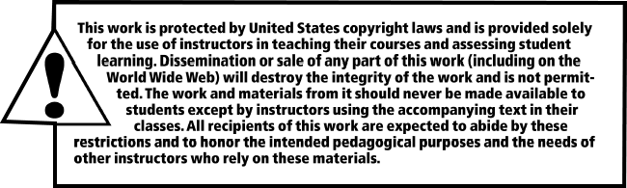
All rights reserved. No part of this publication may be reproduced, stored in a retrieval system, or transmitted, in any form or by any means, electronic, mechanical, photocopying, recording, or otherwise, without the prior written permission of the publisher. Printed in the United States of America.

